Slide 1
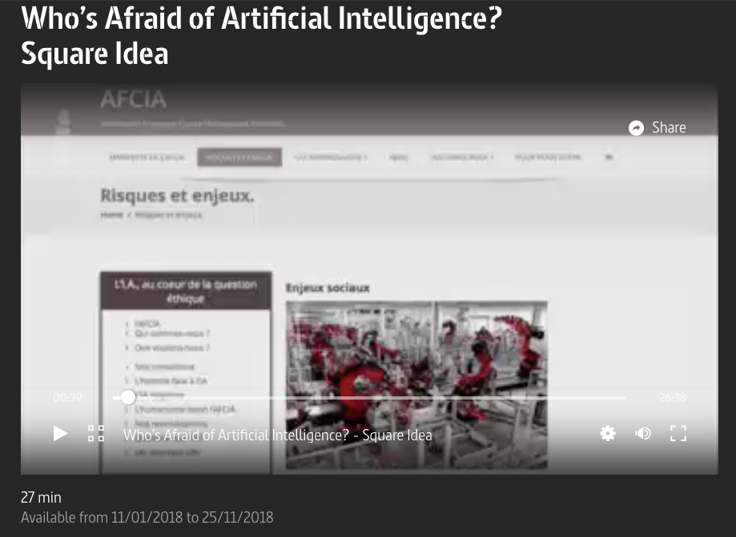
https://www.arte.tv/en/videos/058227-048-A/who-s-afraid-of-artificial-intelligence/

Slide 2
Philip K. dick, Blade Runner
Oscar Sharp, Film director helped by Benjamin to write script
Cédric Sauviat, AFCIA

Slide 3
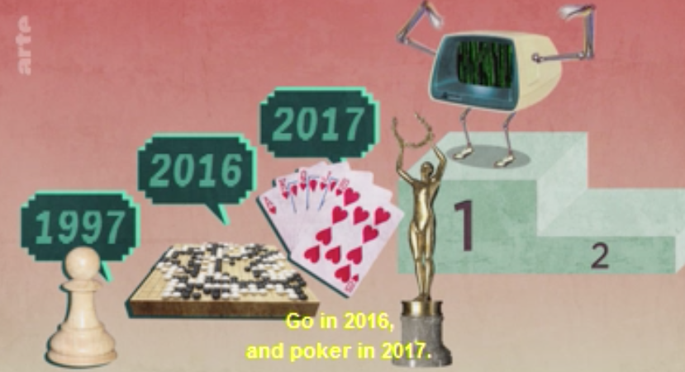

Slide 4
Remplacer l’homme NON!
Jugement esthétique, heuristique,

Slide 5


Slide 6
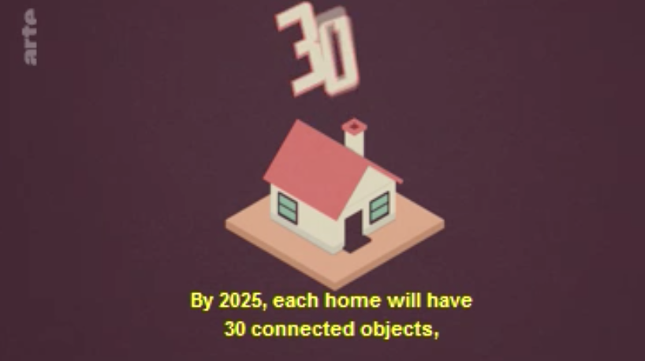
With proper intelligence

Slide 7


Slide 8


Slide 9
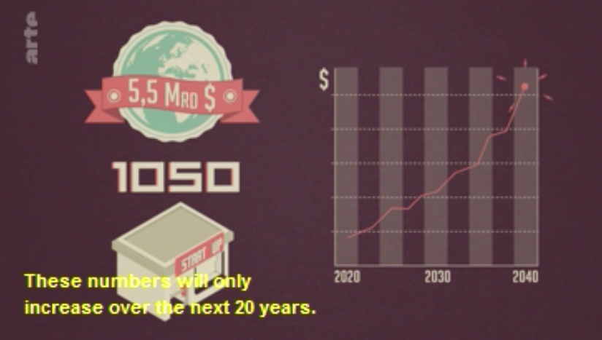

Slide 10
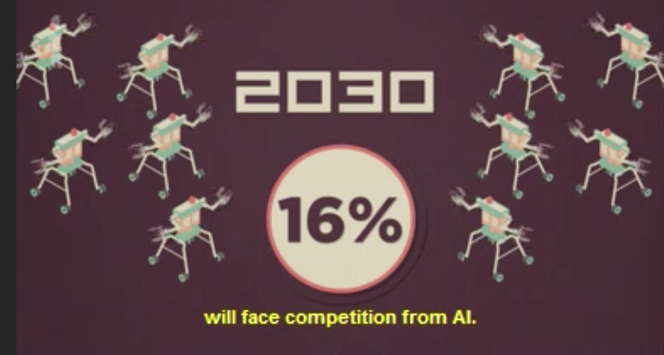

Slide 11
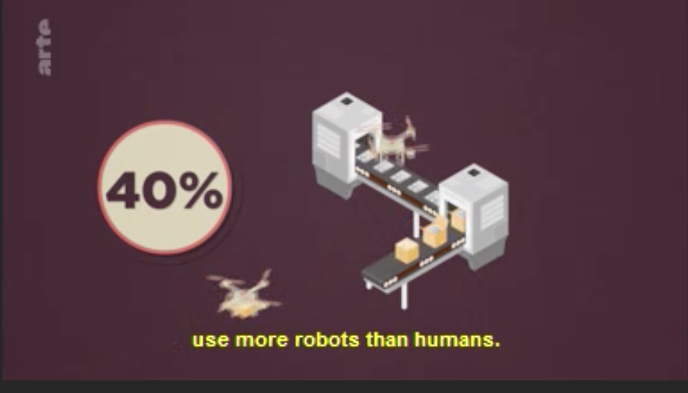

Slide 12
Dystopie?
Augmeting, we increase culture, …

Slide 13


Slide 14
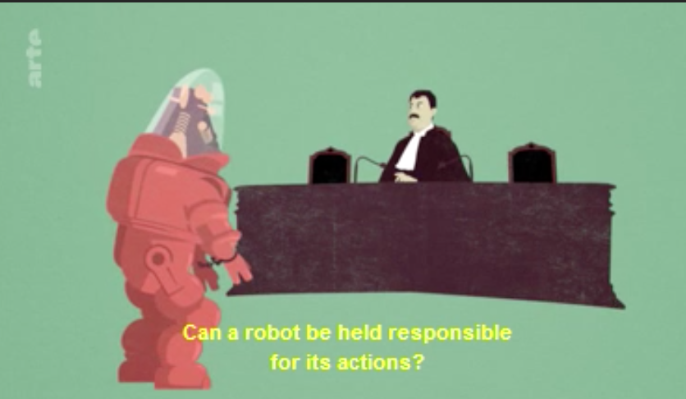
At 21min 22

Slide 15
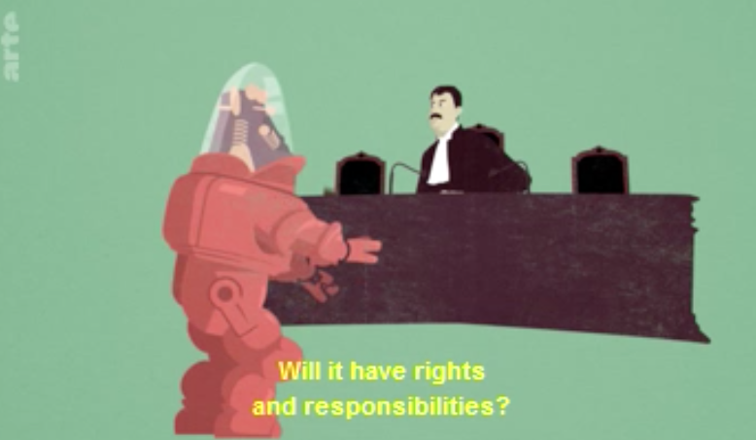

Slide 16
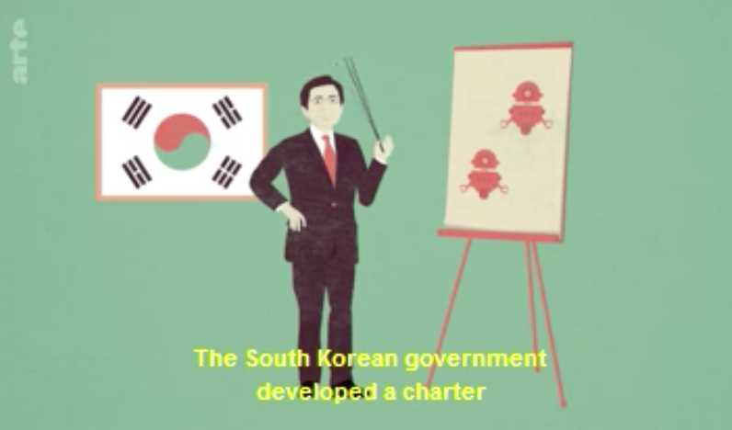

Slide 17
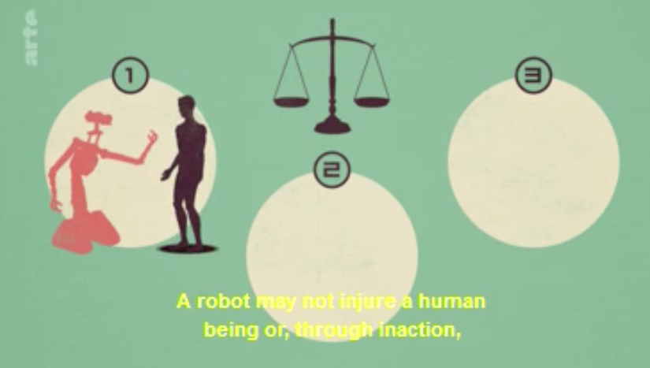

Slide 18
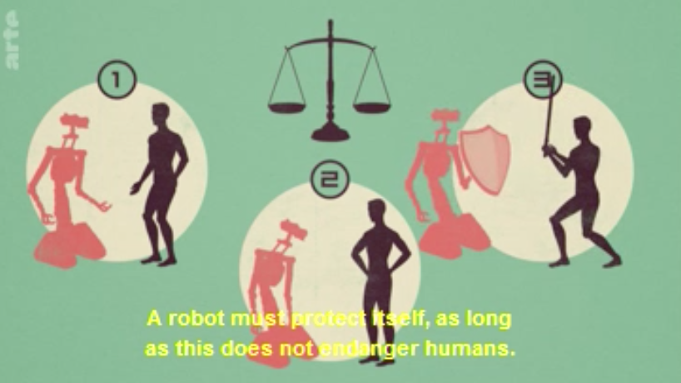

Slide 19
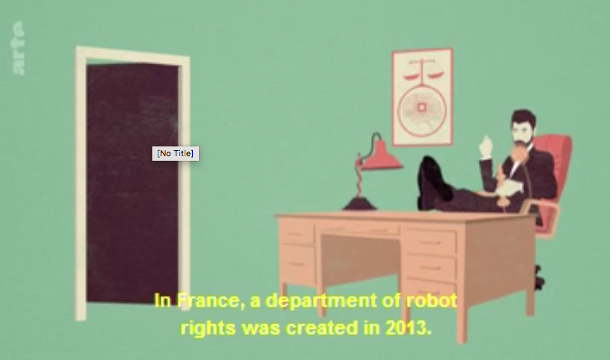

Slide 20
